Slide 1
Network Classes and Subnetting,
Troubleshooting
Lecture 28-30 (Theory)
Department of Computer Science and Engineering,
Chitkara University, Punjab
Prepared by:
Dr. Suvarna Sharma
Computer Networks

Slide 2
Index
1. Logical Addressing
2. Classful Addressing
3. Hierarchy of IPv4 Addresses
4. Network Classes (A,B,C,D,E)
5. Subnetting
Computer Networks
‹#›

Slide 3
Logical Addressing
Network Addressing is one of the major responsibilities of the network layer.
Network addresses are always logical, i.e., software-based addresses.
A host is also known as end system that has one link to the network. The boundary between the host and link is known as an interface. Therefore, the host can have only one interface.
A router is different from the host in that it has two or more links that connect to it. The boundary between the router and link is known as an interface, and the router can have multiple interfaces, one for each of its links. Each interface is capable of sending and receiving the IP packets, so IP requires each interface to have an address.
Each IP address is 32 bits long, and they are represented in the form of "dot-decimal notation" where each byte is written in the decimal form, and they are separated by the period. An IP address would look like 193.32.216.9 where 193 represents the decimal notation of first 8 bits of an address, 32 represents the decimal notation of second 8 bits of an address, and so on.
Computer Networks
‹#›

Slide 4
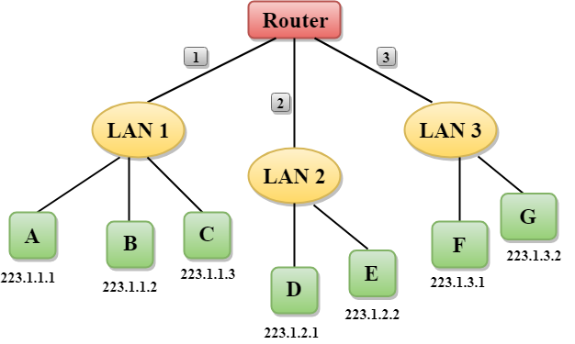
Logical Addressing (contd.)
Figure 1: Router and IP Addressing
Computer Networks
‹#›

Slide 5
Logical Addressing (contd.)
In the Figure 1, a router has three interfaces labeled as 1, 2 & 3 and each router interface contains its own IP address.
Each host contains its own interface and IP address.
All the interfaces attached to the LAN 1 is having an IP address in the form of 223.1.1.xxx, and the interfaces attached to the LAN 2 and LAN 3 have an IP address in the form of 223.1.2.xxx and 223.1.3.xxx respectively.
Each IP address consists of two parts. The first part (first three bytes in IP address) specifies the network and second part (last byte of an IP address) specifies the host in the network.
Computer Networks
‹#›

Slide 6
IPv4 ADDRESSES
An IPv4 address is a 32-bit address that uniquely and universally defines the connection of a device (for example, a computer or a router) to the Internet.
Each computer in a TCP/IP network must be given a unique identifier, or IP address.
This address, which
operates at Layer 3, allows one computer to locate another computer on a network.
An address space is the total number of addresses used by the protocol.
The address space of IPv4 is 2³² or 4,294,967,296 (more than 4 billion).
If a device operating at the network layer has m connections to the internet, it needs to have m addresses. E.g.: router
Computer Networks
‹#›

Slide 7
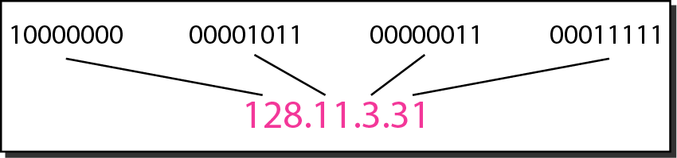
IPv4 ADDRESSES (contd.)
Figure 2: Dotted-decimal notation and binary notation for an IPv4 address
Computer Networks
‹#›

Slide 8
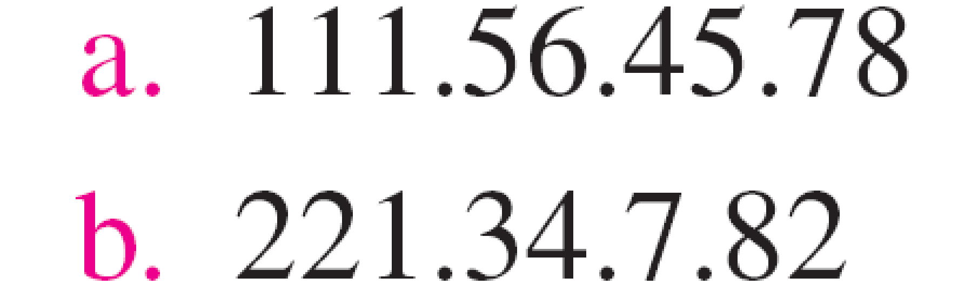
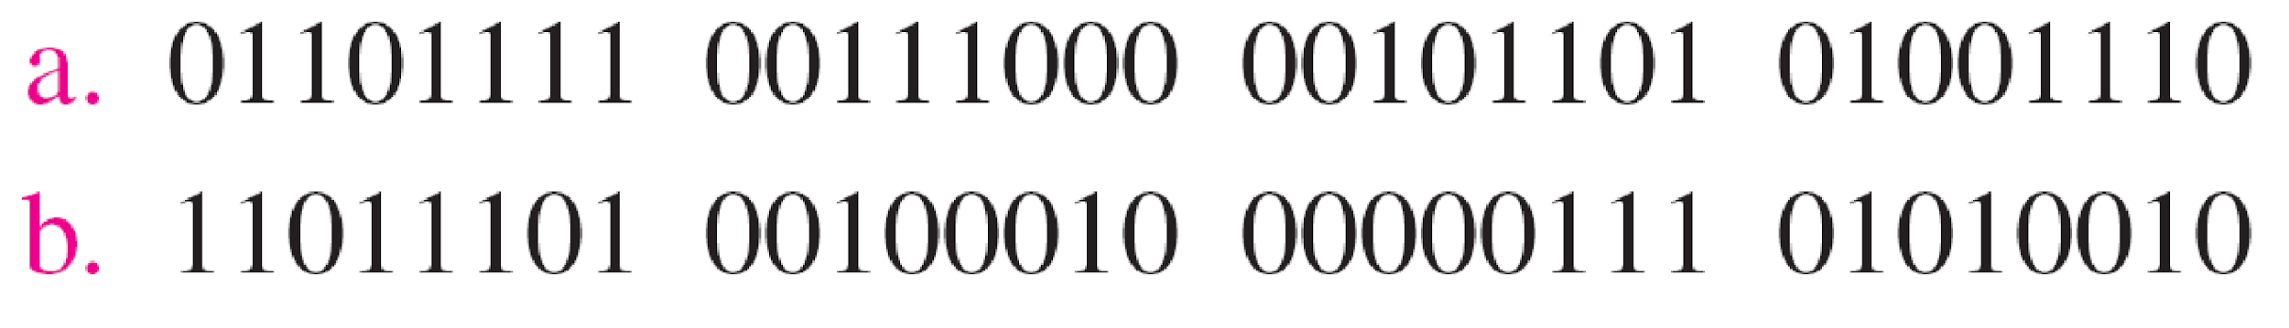
Example
Change the following IPv4 addresses from dotted-decimal notation to binary notation.
Solution
We replace each decimal number with its binary equivalent.
Computer Networks
‹#›

Slide 9
Classful Addressing
An IP address is 32-bit long. An IP address is divided into sub-classes:
Class A
Class B
Class C
Class D
Class E
An IP address is divided into two parts:
Network ID: It represents the number of networks.
Host ID: It represents the number of hosts.
Computer Networks
‹#›

Slide 10
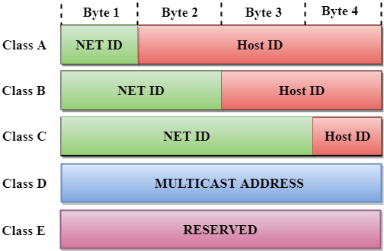
In the diagram, we observe that each class have a specific range of IP addresses. The class of IP address is used to determine the number of bits used in a class and number of networks and hosts available in the class.
Classful Addressing (contd.)
Figure 3: Classful Addressing
Computer Networks
‹#›

Slide 11
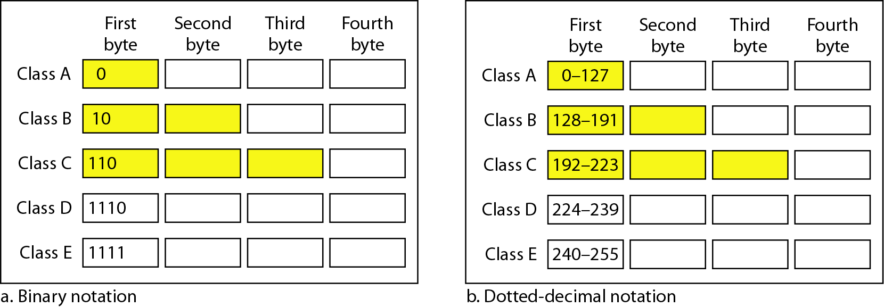
Classful Addressing (contd.)
Figure 4: Finding the classes in binary and dotted-decimal notation
Computer Networks
‹#›

Slide 12
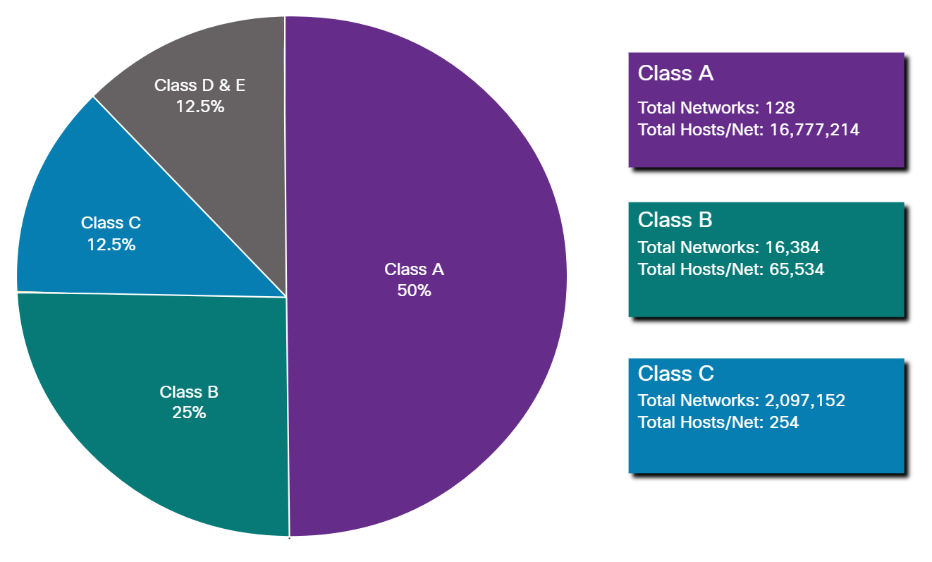
Classful Addressing (contd.)
Figure 5: Networks and Hosts in classes

Slide 13

Class A
In Class A, an IP address is assigned to those networks that contain a large number of hosts.
The network ID is 8 bits long.
The host ID is 24 bits long.
In Class A, the first bit in higher order bits of the first octet is always set to 0 and the remaining 7 bits determine the network ID. The 24 bits determine the host ID in any network.
The total number of networks in Class A = 2⁷ = 128 network address
The total number of hosts in Class A = 2²⁴ - 2 = 16,777,214 host address
Computer Networks
‹#›

Slide 14

Class B
In Class B, an IP address is assigned to those networks that range from small-sized to large-sized networks.
The Network ID is 16 bits long.
The Host ID is 16 bits long.
In Class B, the higher order bits of the first octet is always set to 10, and the remaining14 bits determine the network ID. The other 16 bits determine the Host ID.
The total number of networks in Class B = 2¹⁴ = 16384 network address
The total number of hosts in Class B = 2¹⁶ - 2 = 65534 host address
Computer Networks
‹#›

Slide 15

Class C
In Class C, an IP address is assigned to only small-sized networks.
The Network ID is 24 bits long.
The host ID is 8 bits long.
In Class C, the higher order bits of the first octet is always set to 110, and the remaining 21 bits determine the network ID. The 8 bits of the host ID determine the host in a network.
The total number of networks = 2²¹ = 2097152 network address
The total number of hosts = 2⁸ - 2 = 254 host address
Computer Networks
‹#›

Slide 16

Class D
In Class D, an IP address is reserved for multicast addresses. It does not possess subnetting.
The higher order bits of the first octet is always set to 1110, and the remaining bits determines the host ID in any network.
Computer Networks
‹#›

Slide 17

Class E
In Class E, an IP address is used for the future use or for the research and development purposes. It does not possess any subnetting. The higher order bits of the first octet is always set to 1111, and the remaining bits determines the host ID in any network.
Computer Networks
‹#›

Slide 18
Classful Addressing
A block in class A address is too large for almost any organization. It means that most of the IP addresses in class A were wasted.
A block in class B is also very large.
A block in class C is probably too small for many organizations.
Class D addresses were designed for multicasting. Each IP address in this class is used to define one group of hosts on the Internet. The Internet authorities wrongly predicted a need of 268,435,456 groups. This never happened and many IP addresses were wasted.
Class E IP addresses were reserved for future use; only a few were used, resulting in another waste of IP addresses
Computer Networks
‹#›

Slide 19
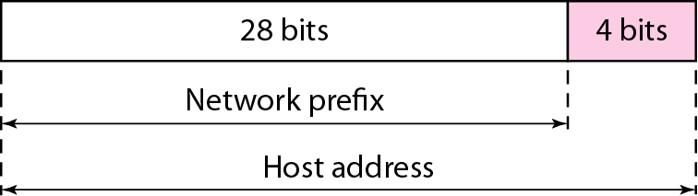
Two level hierarchy in an IPv4 address
Leftmost n bits (prefix) define the network id and,
The right most 32-n (suffix) bits define the host id.
The prefix is common to all devices in the network, suffix changes from one device to another.
Computer Networks
‹#›

Slide 20
Netid and Hostid:
This concept does not apply to class D and E.
For class A, one byte defines netid, and three bytes define hostid.
In class B, two bytes define the netid, and two bytes define the hostid.
In class C, three bytes define the netid , and one byte defines the hostid.
Computer Networks
‹#›

Slide 21
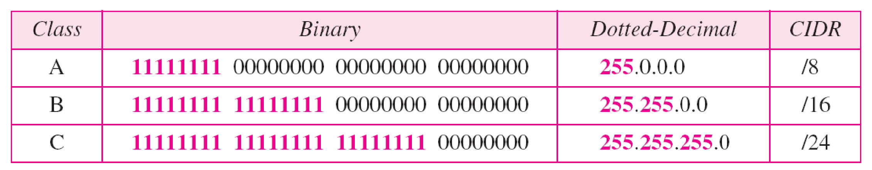
Network Masks
Mask:
The concept does not apply to classes D and E.
The mask can help us find netid and hostid.
The last column shows the mask in the form /n, where n can be 8,16, or 24. This notation is called slash notation or Classless Interdomain Routing (CIDR) notation.
Figure 6: Default masks for classful addressing
Computer Networks
‹#›

Slide 22
Network Masks (Contd.)
An IP address on a Class A network that has not been subnetted would have an address/mask pair similar to: 10.20.15.1 255.0.0.0.
In order to see how the mask helps you identify the network and node parts of the address, convert the address and mask to binary numbers.
10.20.15.1 = 00001010.00010100.00001111.00000001
255.0.0.0 = 11111111.00000000.00000000.00000000
Once you have the address and the mask represented in binary, then identification of the network and host ID is easier. Any address bits which have corresponding mask bits set to 1 represent the network ID. Any address bits that have corresponding mask bits set to 0 represent the node ID.
10.20.15.1 = 00001010.00010100.00001111.00000001
255.0.0.0 = 11111111.00000000.00000000.00000000
--------------------------------------------------
net id | host id
netid = 00001010 = 10
hostid = 00010100.00001111.00000001 = 20.15.1
Computer Networks
‹#›

Slide 23
Rules for assigning Host ID:
The Host ID is used to determine the host within any network. The Host ID is assigned based on the following rules:
The Host ID must be unique within any network.
The Host ID in which all the bits are set to 0 cannot be assigned as it is used to represent the network ID of the IP address.
The Host ID in which all the bits are set to 1 cannot be assigned as it is reserved for the multicast address.
Computer Networks
‹#›

Slide 24
Rules for assigning Network ID:
If the hosts are located within the same local network, then they are assigned with the same network ID. The following are the rules for assigning Network ID:
The network ID cannot start with 127 as 127 is used by Class A.
The Network ID in which all the bits are set to 0 cannot be assigned as it is used to specify a particular host on the local network.
The Network ID in which all the bits are set to 1 cannot be assigned as it is reserved for the multicast address.
Computer Networks
‹#›

Slide 25
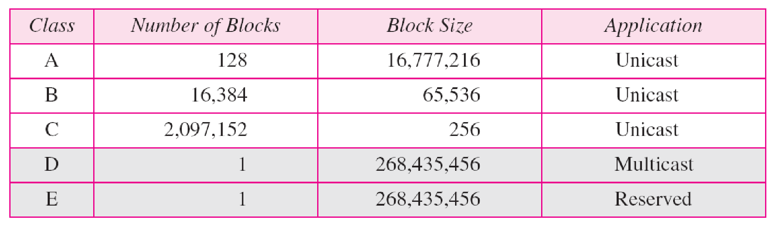
Figure 7: Number of blocks and block size in classful IPv4 addressing
Computer Networks
‹#›

Slide 26
Class | Higher bits | NET ID bits | HOST ID bits | No. of networks | No. of hosts per network | Range
A | 0 | 8 | 24 | 2⁷ | 2²⁴ | 0.0.0.0 to 127.255.255.255
B | 10 | 16 | 16 | 2¹⁴ | 2¹⁶ | 128.0.0.0 to 191.255.255.255
C | 110 | 24 | 8 | 2²¹ | 2⁸ | 192.0.0.0 to 223.255.255.255
D | 1110 | Not defined | Not defined | Not defined | Not defined | 224.0.0.0 to 239.255.255.255
E | 1111 | Not defined | Not defined | Not defined | Not defined | 240.0.0.0 to 255.255.255.255
Computer Networks
‹#›

Slide 27
Classless Addressing
Classless Addressing is one of the IP(Internet Protocol) address classifications. IP addresses are unique and universal. No two hosts will simultaneously have the same IP address in the world. The most common use of the classless addressing system Or Classless interdomain routing (CIDR) for actually addressing is to combine two or more class C networks to create a /23 or /22 Supernet.
To overcome address depletion and give Internet access to more organizations, classless addressing was designed and implemented.
In this scheme, there are no classes but the addresses are still granted in blocks.
Number of Addresses in a Block
There is only one condition on the number of addresses in a block; it must be a power of 2 (2, 4, 8, ...).
A household may be given a block of 2 addresses.
A small business may be given 16 addresses.
A large organization may be given 1024 addresses.
Computer Networks
‹#›

Slide 28
Classless Addressing (Contd.)
Beginning Address
The beginning address must be evenly divisible by the number of addresses.
For example, if a block contains 4 addresses, the beginning address must be divisible by 4.
If the block has less than 256 addresses, we need to check only the rightmost byte.
If it has less than 65,536 addresses, we need to check only the two rightmost bytes, and so on.
Computer Networks
‹#›

Slide 29
Examples
Which of the following can be the beginning address of a block that contains 16 addresses?
205.16.37.32
190.16.42.44
17.17.33.80
123.45.24.52
Solution
The address 205.16.37.32 is eligible because 32 is divisible by16.
The address 17.17.33.80 is eligible because 80 is divisible by 16.

Slide 30
Examples
Which of the following can be the beginning address of a block that contains 1024 addresses?
205.16.37.32
190.16.42.0
17.17.32.0
123.45.24.52
Solution
To be divisible by 1024, the rightmost byte of an address should be 0 and the second rightmost byte must be divisible by 4. Only the address 17.17.32.0 meets this condition.

Slide 31
Subnetting
If an organization was granted a large block in class A or B, it could divide the addresses into several contiguous groups and assign each group to smaller networks (called subnets).
Subnetting increases the number of 1s in the mask.
Computer Networks
‹#›

Slide 32
Supernetting
The size of a class C block with a maximum number of 256 addresses did not satisfy the needs of most organizations.
In supernetting, an organization can combine several class C blocks to create a larger range of addresses.
In other words, several networks are combined to create a supernetwork or supernet.
E.g. an organization that needs 1000 addresses can be granted four contiguous class C blocks.
Supernetting decreases the number of 1s in the mask.
E.g. if an organization is given four class C blocks, the mask changes from /24 to /22.
Classless addressing eliminated the need for supernetting.
Computer Networks
‹#›

Slide 33
Address Blocks
In classless addressing, when an entity small or large, needs to be connected to the Internet, it is granted a block of addresses. The size of the block varies based on the need of the organization.
Restriction-
The addresses in a block must be contiguous.
The no of addresses in a block must be a power of 2.
The first address must be evenly divisible by the number of addresses.
Computer Networks
‹#›

Slide 34
Example
Figure (on next slide) shows a block of addresses, in both binary and dotted-decimal notation, granted to a small business that needs 16 addresses.
We can see that the restrictions are applied to this block. The addresses are contiguous.
The number of addresses is a power of 2 (16 = 2⁴), and the first address is divisible by 16.
The first address, when converted to a decimal number, is 3,440,387,360, which when divided by 16 results in 215,024,210.
Computer Networks
‹#›

Slide 35
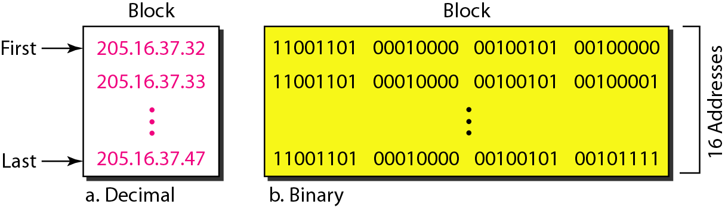
Example (contd.)
Figure 8: A block of 16 addresses granted to a small organization
Computer Networks
‹#›

Slide 36
In IPv4 addressing, a block of addresses can be defined as
x.y.z.t /n
in which x.y.z.t defines one of the addresses and the /n defines the mask.
Computer Networks
‹#›

Slide 37
The first address in the block can be found by setting the rightmost 32 − n bits to 0s.
Computer Networks
‹#›

Slide 38
Example
A block of addresses is granted to a small organization. We know that one of the addresses is 205.16.37.39/28. What is the first address in the block?
Solution:
The block of addresses 205.16.37.39/28 represents a subnet with a subnet mask of 28 bits.
To determine the first and last addresses in the block, we need to convert the subnet mask to its binary representation and perform some calculations.
The subnet mask 28 means that the first 28 bits of the IP address represent the network portion, and the remaining 4 bits are available for host addresses.
Converting the subnet mask 28 to binary results in 32 bits with the first 28 bits set to 1 and the last 4 bits set to 0:
11111111.11111111.11111111.11110000
To calculate the first address, we perform a logical AND operation between the given address (205.16.37.39) and the subnet mask:
Address: 11001101.00010000.00100101.00100111
Subnet Mask: 11111111.11111111.11111111.11110000
AND Operation: 11001101.00010000.00100101.00100000
The result of the AND operation gives us the network address, which is 205.16.37.32.
Therefore, the first address in the block is 205.16.37.32.
Computer Networks
‹#›

Slide 39
Network Address:
The first address is called the network address and defines the organization network
First address is used as the network address that represents the organization to the rest of the world.
Computer Networks
‹#›

Slide 40
The last address in the block can be found by setting the rightmost 32 - n bits to 1s.
Computer Networks
‹#›

Slide 41
Example
A block of addresses is granted to a small organization. We know that one of the addresses is 205.16.37.39/28. What is the last address in the block?
Solution:
To calculate the last address, we need to find the highest possible host address within the block. Since we have 4 bits available for host addresses (2^4 = 16), the highest host address is obtained by setting all 4 bits to 1:
Address: 11001101.00010000.00100101.00100111
Subnet Mask: 11111111.11111111.11111111.11110000
OR Operation: 11001101.00010000.00100101.00101111
The result of the OR operation gives us the broadcast address, which is 205.16.37.47. However, the last address in the block is always reserved as the broadcast address, so the actual last usable address is the one before the broadcast address. Therefore, the last address in the block is 205.16.37.46.
Computer Networks
‹#›

Slide 42
The number of addresses in the block can be found by using the formula 2^{32-n}.
Computer Networks
‹#›

Slide 43
Three level of Hierarchy: subnetting
An organization that is granted a large block of addresses may want to create clusters of networks (subnets) and divide the addresses between the different subnets.
The rest of the world still sees the organization as one entity; however internally there are several subnets.
All messages are sent to the router that connects the organization to the rest of the Internet; the router routes the message to the appropriate subnets.
The organization has its own mask and each subnet must also have its own.
Computer Networks
‹#›

Slide 44
Example
Suppose an organization is given the block 17.12.40.0/26, which contains 64 IP addresses. The organization has three offices and needs to divide the addresses into three subblocks of 32,16, and 16 IP addresses.
We can find the new masks as
Suppose the mask for the first subnet is n₁ then 2^{32-n1} must be 32, which means n₁=27.
Suppose the mask for the second subnet is n₂ then 2^{32-n2} must be 16, which means n₁=28.
Suppose the mask for the third subnet is n₃ then 2^{32-n3} must be 16, which means n₁=28.
Computer Networks
‹#›

Slide 45
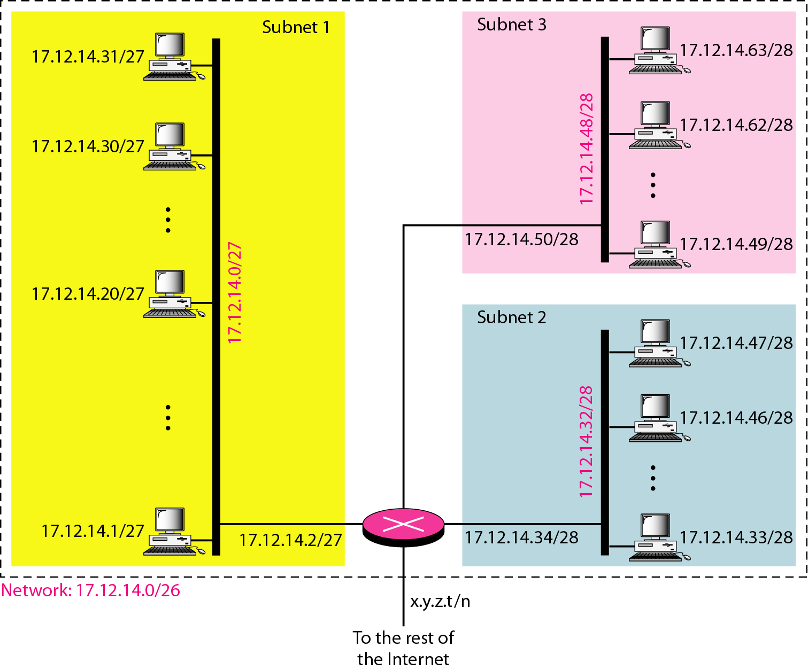
Example (contd.)
Figure 9: Configuration and addresses in a subnetted network
Computer Networks
‹#›

Slide 46
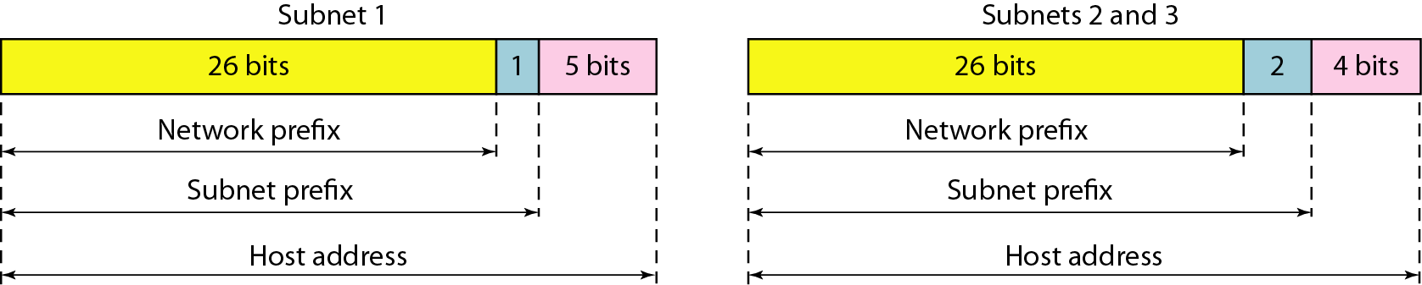
Three-level hierarchy in an
IPv4 address
Figure 10: Three-level hierarchy in an IPv4 address
Computer Networks
‹#›

Slide 47
Example
An ISP is granted a block of addresses starting with 190.100.0.0/16 (65,536 addresses). The ISP needs to distribute these addresses to three groups of customers as follows:
a. The first group has 64 customers; each needs 256 addresses.
b. The second group has 128 customers; each needs 128 addresses.
c. The third group has 128 customers; each needs 64 addresses.
Design the subblocks and find out how many addresses are still available after these allocations.
Computer Networks
‹#›

Slide 48
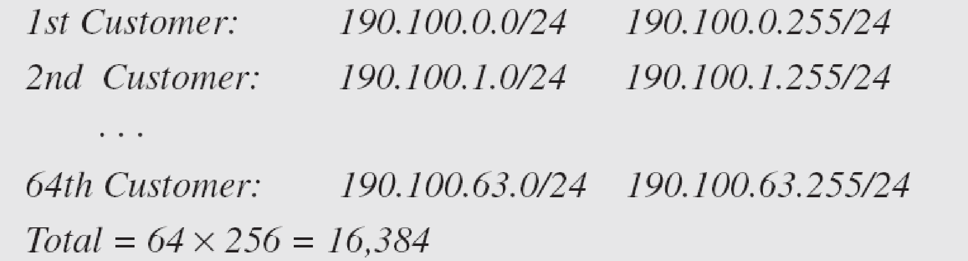
Example (contd.)
Solution
Group 1
For this group, each customer needs 256 addresses. This means that 8 (log₂ 256) bits are needed to define each host. The prefix length is then 32 − 8 = 24. The addresses are
‹#›

Slide 49
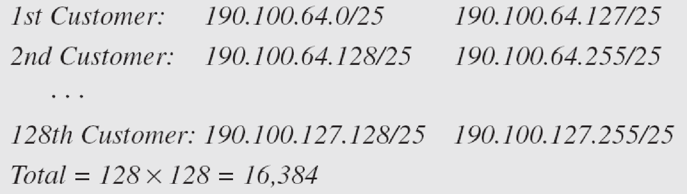
Example (contd.)
Group 2
For this group, each customer needs 128 addresses. This means that 7 (log₂ 128) bits are needed to define each host. The prefix length is then 32 − 7 = 25. The addresses are
‹#›

Slide 50
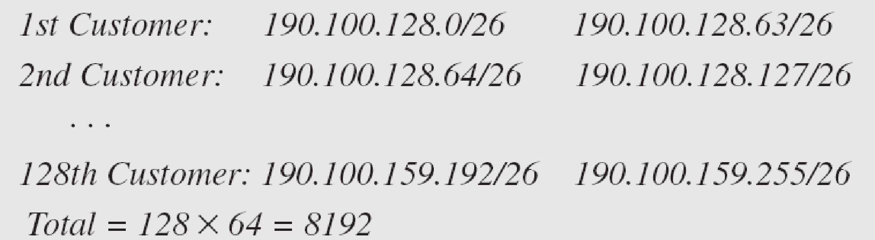
Example (contd.)
Group 3
For this group, each customer needs 64 addresses. This means that 6 (log₂64) bits are needed to each host. The prefix length is then 32 − 6 = 26. The addresses are
Number of granted addresses to the ISP: 65,536
Number of allocated addresses by the ISP: 40,960
Number of available addresses: 24,576
‹#›

Slide 51
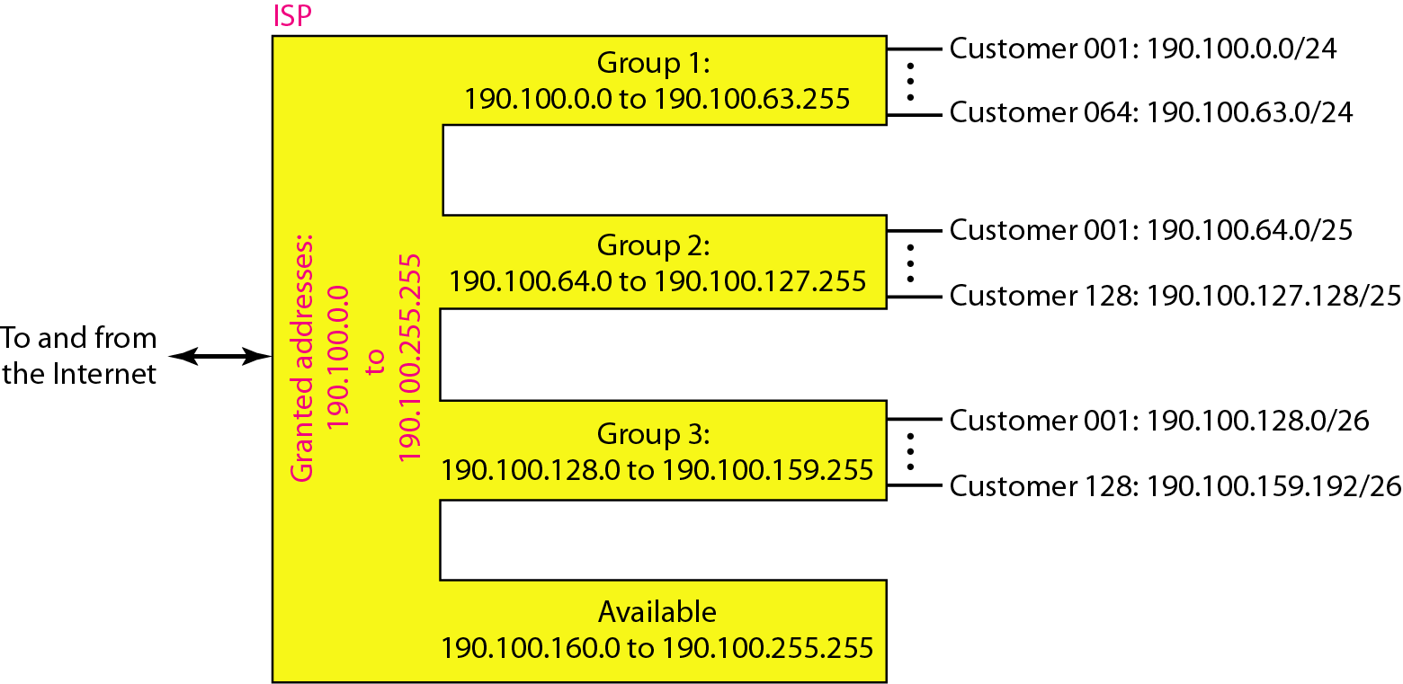
Example (contd.)
Figure 11: An example of address allocation and distribution by an ISP
‹#›

Slide 52
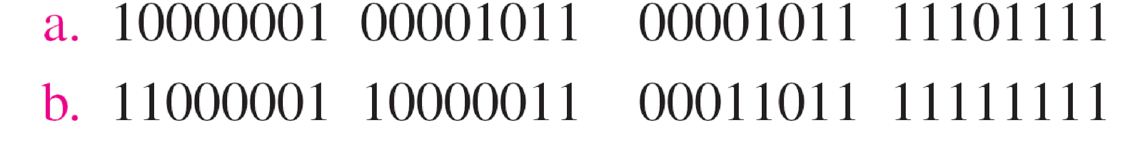
Practice Questions
Change the following IPv4 addresses from binary notation to dotted-decimal notation.
‹#›

Slide 53
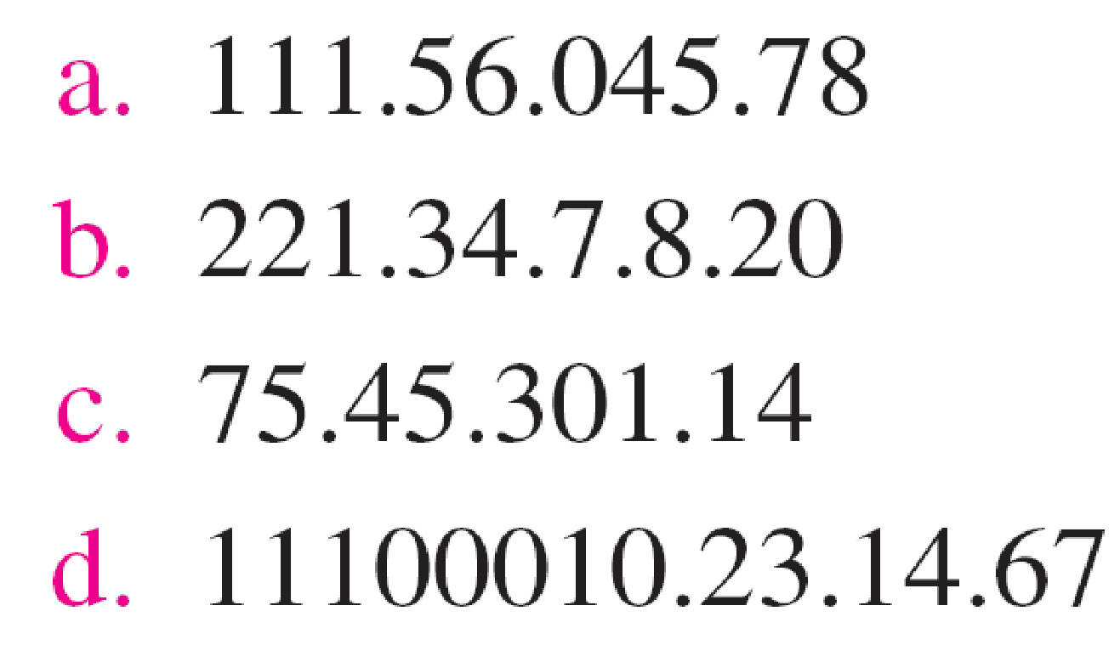
Practice Questions
Find the error, if any, in the following IPv4 addresses.
‹#›

Slide 54
Practice Questions
Find the class of each address.
a. 00000001 00001011 00001011 11101111
b. 11000001 10000011 00011011 11111111
c. 14.23.120.8
d. 252.5.15.111
‹#›

Slide 55
Practice Questions
A block of addresses is granted to a small organization. We know that one of the addresses is 205.16.37.39/28. Find the number of addresses in this block.
Computer Networks
‹#›

